Slide 1


BANK MARKETING CAMPAIGN
-Jamsheer Kutty
-Chanchal Kedia
-Mahesh Sharma
-Shreejit Nair
-Renuka Srivastva

Slide 2

Pipeline
Obtaining the data
Scrubbing or cleaning the data
Exploring the Data
Modeling the data
Interpreting the data

Slide 3

What
is the Problem?
Portuguese Bank Marketing Campaign based on phone call to access if Client will subscribe for Term Deposit.
What if we could know it before hand?
Let’s build a suitable model to Predict the subscription.

Slide 4
The Data..
Anonymized data[41188,21]:
Train [ 35810,14], Test[15348,14]
Features:
7 Continuous [Age, Duration, emp.var.rate, cons.price.idx, cons.conf.idx, euribor3m, nr.employed]
3 Discrete [campaign, pdays, previous]
10 Categorial [ job, marital, education, default, housing, loan, contact, month, day_of_week, poutcome]
There are no null values in the datasets in the columns
Classification Target:
y[ yes , no]

Slide 5
Bank client data
Age (numeric)
Job : type of job (categorical: 'admin.', 'blue-collar', 'entrepreneur’,etc)
Marital : marital status (categorical: 'divorced', 'married', 'single', 'unknown’ )
Education (categorical: 'basic.4y', lliterate', 'professional.course', 'university.degree’, etc)
Default: has credit in default? (categorical: 'no', 'yes', 'unknown')
Housing: has housing loan? (categorical: 'no', 'yes', 'unknown')
Loan: has personal loan? (categorical: 'no', 'yes', 'unknown’)
Last contact regarding current campaign
Contact: contact communication type (categorical: 'cellular','telephone')
Month: last contact month (categorical: 'jan', 'feb', 'mar', ..., 'nov', 'dec')
Day_of_week: last contact day of the week (categorical: 'mon','tue','wed','thu','fri')
Duration: last contact duration, in seconds (numeric).
Campaign: number of contacts performed during this campaign and for this client (numeric, includes last contact)
Pdays: number of days that passed by after the client was last contacted from a previous campaign (numeric; 999 means client was not previously contacted)
Previous: number of contacts performed before this campaign and for this client (numeric)
Poutcome: outcome of the previous marketing campaign (categorical: 'failure','nonexistent','success’)
Economic Index Attributes :
Emp.var.rate: employment variation rate (numeric)
Cons.price.idx: consumer price index (numeric)
Cons.conf.idx: consumer confidence index (numeric)
Euribor3m: euribor 3 month rate (numeric)
Nr.employed: number of employees (numeric)

Slide 6
Importing the necessary libraries
import pandas as pd
import numpy as np
import seaborn as sns
import matplotlib.pyplot as plt
import graphviz
from sklearn.preprocessing import LabelEncoder
from sklearn.model_selection import cross_val_score, train_test_split, f1_score, make_scorer
from sklearn.linear_model import LogisticRegression
from sklearn.metrics import classification_report, accuracy_score, confusion_matrix
from sklearn.svm import SVC
from sklearn.ensemble import RandomForestClassifier, VotingClassifier
from sklearn.linear_model import LogisticRegression
from sklearn.ensemble import RandomForestClassifier
from sklearn.tree import DecisionTreeClassifier
from sklearn.neighbors import KNeighborsClassifier
from sklearn.svm import SVC, LinearSVC
from sklearn.naive_bayes import GaussianNB
from sklearn.model_selection import GridSearchCV , cross_val_score
from sklearn import tree
from sklearn.tree import DecisionTreeRegressor, DecisionTreeClassifier
from sklearn.metrics import confusion_matrix
from sklearn.metrics import accuracy_score
from sklearn.metrics import classification_report
from imblearn.over_sampling import SMOTE
from sklearn.metrics import roc_curve, roc_auc_score
from sklearn.neighbors import KNeighborsClassifier

Slide 7
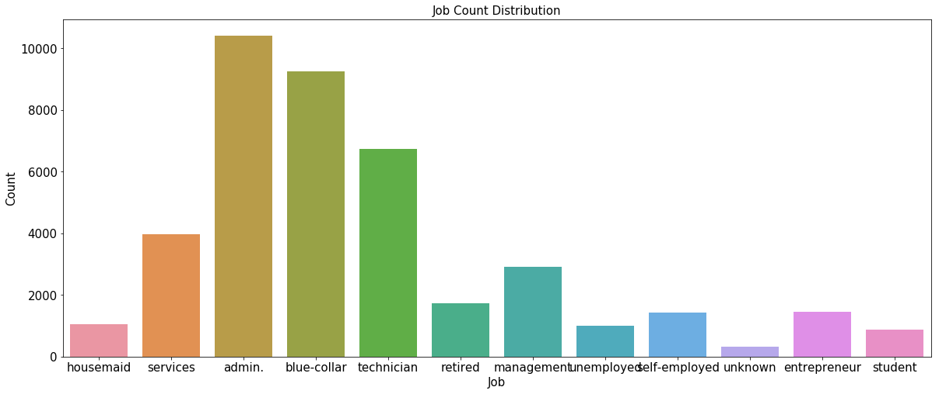
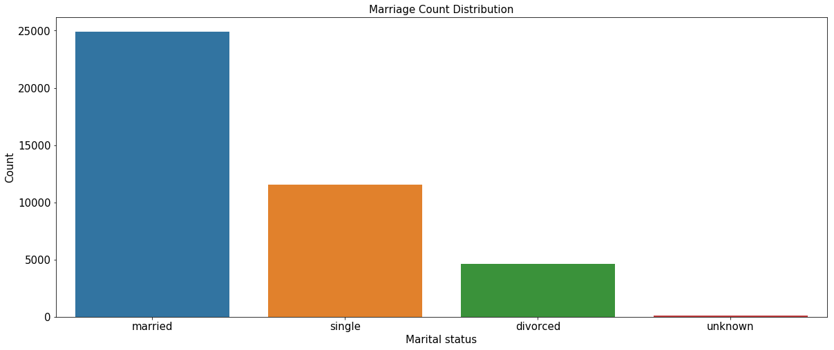
Checking the spread of each categorical columns
Univariate Analysis of Client Data

Slide 8
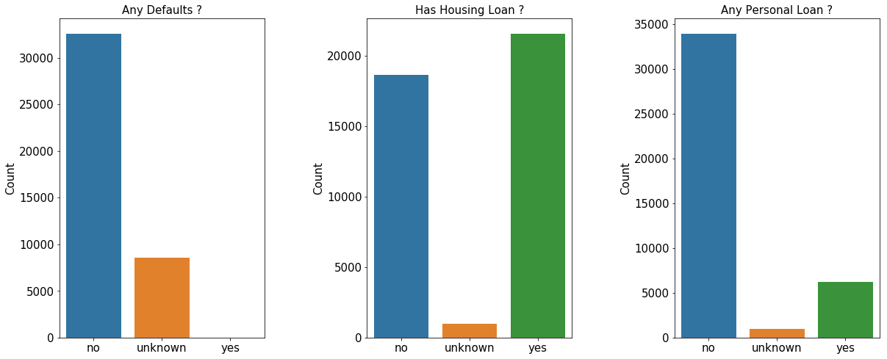

Slide 9
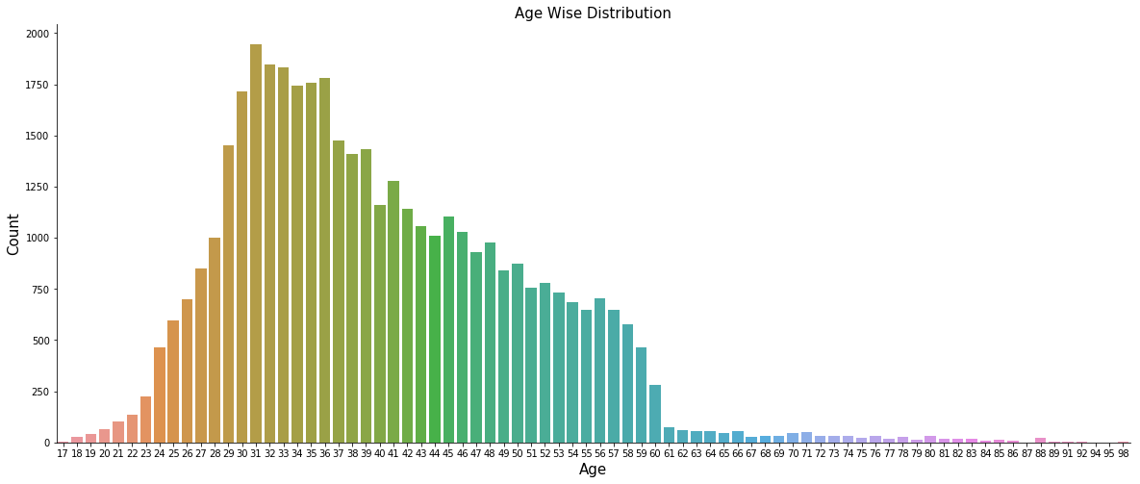
Checking the distribution of Age

Slide 10
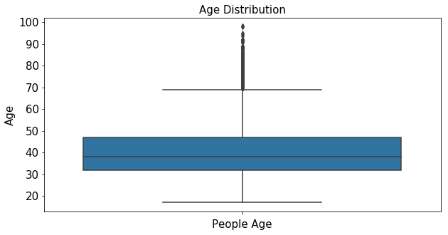
Checking the outliers in Age
Age data has quite dispersion , we will divide it into buckets based on outliers
Q1=quantile(q = 0.25) ,value =32
Q2=quantile(q = 0.50), value=38
Q3=quantile(q = 0.75), value=47
Q4=quantile(q = 1.00) ,value=98
IQR= Q3-Q1 , values=15
Ages above Q3 + 1.5*(IQR) are outliers , value=69.5

Slide 11
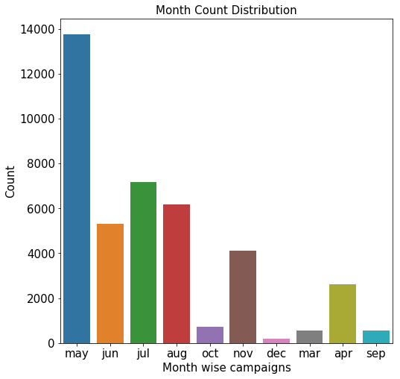
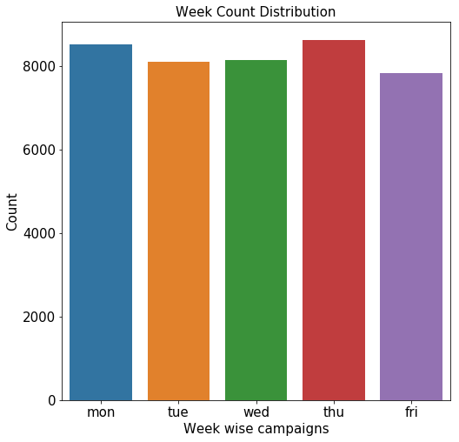
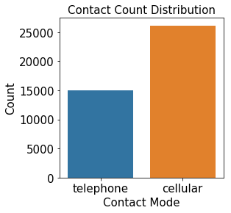
Marketing Data

Slide 12
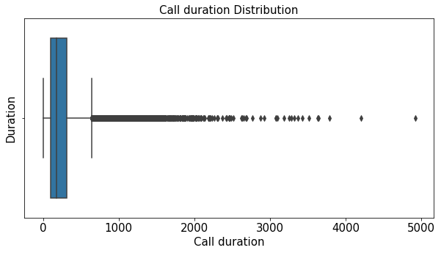
Checking the outliers in Duration:
Duration data has quite dispersion , we will divide it into buckets based on outliers
Q1=quantile(q = 0.25) ,value =102
Q2=quantile(q = 0.50), value=180
Q3=quantile(q = 0.75), value=319
Q4=quantile(q = 1.00) ,value=4918
IQR= Q3-Q1 , values=217
Duration above Q3 + 1.5*(IQR) are outliers , value=644.5

Slide 13
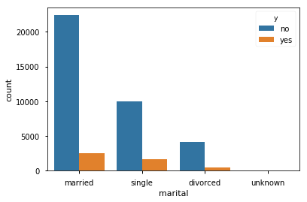
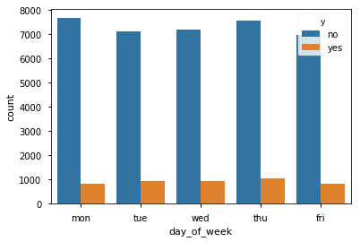
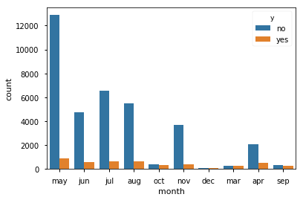
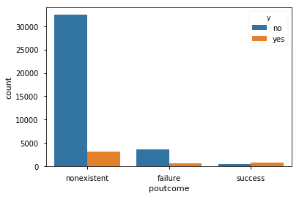
Bivariate Analysis

Slide 14
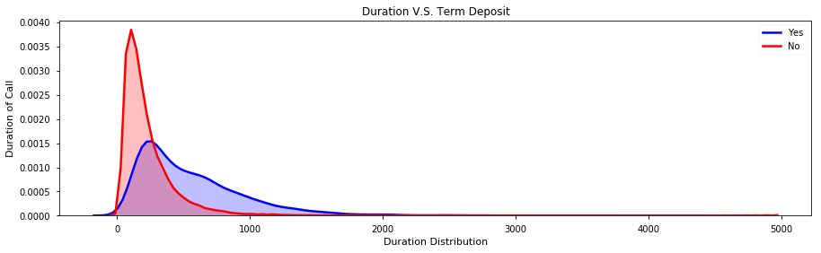

Slide 15
Categorial to Numerical Conversion
a. Duration divided to buckets as follows :
df.loc[df['duration'] <= 102, 'duration'] = 1
df.loc[(df['duration'] > 102) & (df['duration'] <= 180) , 'duration'] = 2
df.loc[(df['duration'] > 180) & (df['duration'] <= 319) , 'duration'] = 3
df.loc[(df['duration'] > 319) & (df['duration'] <= 644.5), 'duration'] = 4
df.loc[df['duration'] > 644.5, 'duration'] = 5
b. Age divided into bucket as follows :
def age(df):
df.loc[df['age'] <= 32, 'age'] = 1
df.loc[(df['age'] > 32) & (df['age'] <= 47), 'age'] = 2
df.loc[(df['age'] > 47) & (df['age'] <= 70), 'age'] = 3
df.loc[(df['age'] > 70), 'age']=4
This bucketing is done based on spread of data and outliers present

Slide 16
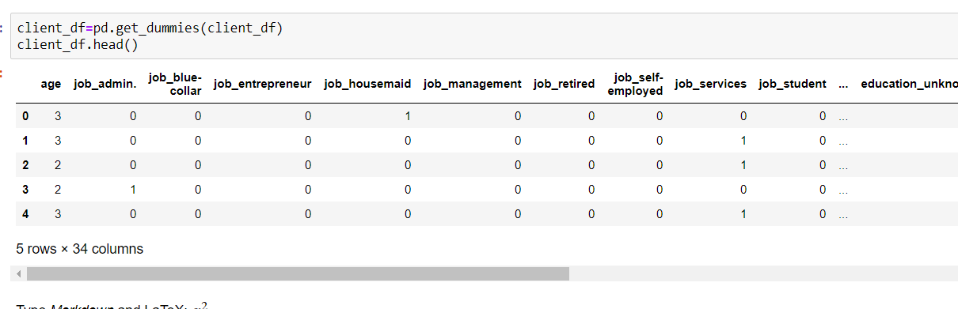
One Hot Encoding of the categorical data

Slide 17
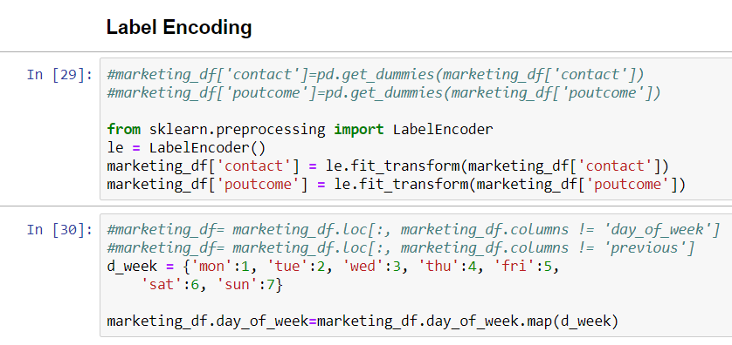
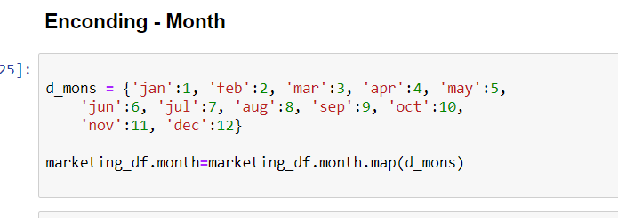
Label Encoding and Mapping of the categorical data

Slide 18
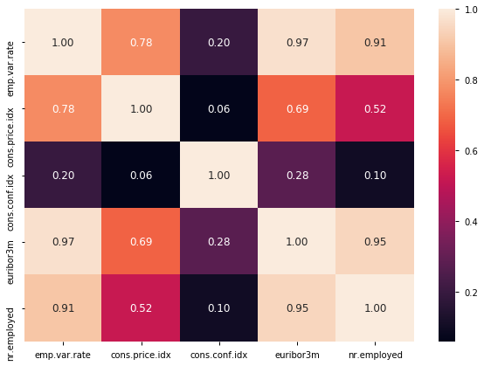
Correlation Matrix of Economic Index

Slide 19
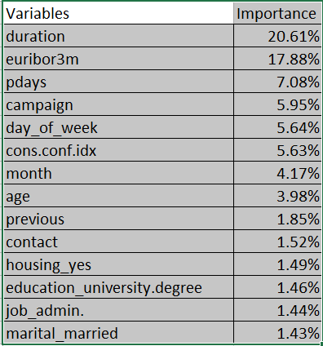
Feature Selection:
Important Features:
Methods used :
Random Forest Classifier (RFC) feature importance
Correlation

Slide 20
SMOTE:
Since our data was highly imbalanced we decide to try out the SMOTE technique which generates synthetic records to balance our minority sample

Slide 21
ML Models
Modeling method | Precision | Recall | Accuracy | F1 Score
Logistic Regression | 0: 0.88 | 0: 0.89 | 0.8498 | 0.89
 | 1: 0.89 | 1: 0.88 |  | 0.89
Random Forest | 0: 0.88 | 0: 0.89 | 0.994 | 0.89
 | 1: 0.89 | 1: 0.88 |  | 0.89
Gaussian Naïve Bayes | 0: 0.88 | 0: 0.89 | 0.7507 | 0.89
 | 1: 0.89 | 1: 0.88 |  | 0.89
SVM | 0: 0.88 | 0: 0.89 | 0.8497 | 0.89
 | 1: 0.89 | 1: 0.88 |  | 0.89
Decision Tree | 0: 0.88 | 0: 0.89 | 0.8872 | 0.89
 | 1: 0.89 | 1: 0.88 |  | 0.89

Slide 22
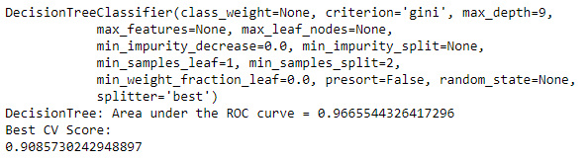

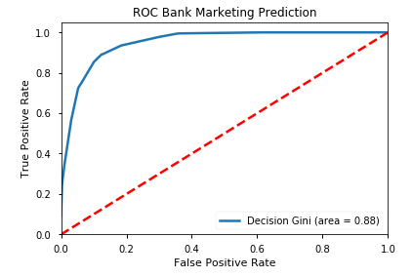
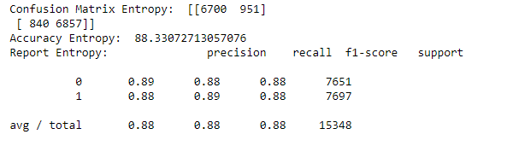
Model Finalization
Decision Tree
Hyper – Parameter Tuning
Confusion Matrix
 | Predicted
Actual | 0 | 1
0 | 6700 | 951
1 | 840 | 6857
3. K-Fold
ROC Curve
4. Testing Accuracy

Slide 23
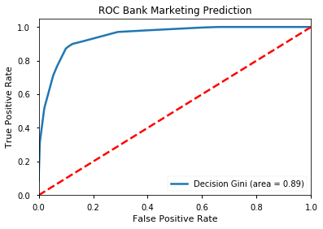
Final Model Selection:
ROC Score using Decision Tree

Slide 24
Conclusions
Customers to be targeted:
Duration : Should be greater than 500 sec
Age : 30 – 55
Job : Admin, Blue-collar, Technician
Previous: Multiple Calls to the same customer.
Campaign Targets:
Customers who were not targeted before
Plan campaigns from May through August

Slide 25


